Slide 1


SMART TRAFFIC CONTROL
Presented by:
Shaik Rahila
192311013
CSA1452
Compiler Design
Date: 03/04/2025

Slide 2
Introduction
Overview of the Project
With the rapid urbanization and increase in vehicle usage, traffic congestion has become a major challenge in metropolitan cities. Traditional traffic control systems fail to efficiently manage real-time traffic flow, leading to excessive delays, fuel wastage, and environmental pollution.

Slide 3
Problem Statement
The existing traffic management systems are either time-based or manually controlled, lacking real-time adaptability. There is a need for a smart traffic control system that can dynamically adjust signal timings based on real-time traffic conditions, ensuring efficient vehicle movement

Slide 4
Purpose of the Project
This project aims to develop a Smart Traffic Control System to optimize traffic flow. The system will use real-time traffic data to make informed decisions for signal adjustments.

Slide 5
Objectives
Implement an IoT-enabled traffic monitoring system.
Utilize network protocols for real-time data transmission and communication.
Reduce traffic congestion and waiting time at intersections.
Improve road safety and reduce environmental pollution.
Develop a scalable system that can be deployed in smart cities.

Slide 6
Literature Review / Background
Archana K P, Aravind R, Ranjitha M, Spoorthi Janita & Soumya K, “IOT Based Smart Traffic Management System”, International Journal of Engineering Research Technology (IJERT), vol 9, issue 12, 2278-018
Sabeen Javaid, Ali Sufian, Saima Pervaiz & Mehak Tanveer, “Smart traffic management system using Internet of Things”, 20th International Conference on Advanced Communication Technology (ICACT) (2018).
Mohammed Sarrab, Supriya Pulparambil & Medhat Awadalla, “Development of an IoT based real-time traffic monitoring system for city governance”, Global Transitions Volume 2 (2020)
Marc Funhternhancs, Eric Grosse & Christoph Glock, “Smart lighting systems: state-of- the-art and potential applications in warehouse order picking”, International Journal of Production Research, Volume 59, 2021 – Issue 12.

Slide 7
Methodology
Tools & Frameworks Used
Hardware: Raspberry Pi, Arduino, IOT Sensors, Cameras
Software: Python, Node-RED, MATLAB
Communication Protocols: MQTT, ZigBee, LoRaWAN
Cloud Platform: AWS IoT Core / Google Cloud IoT

Slide 8
Development Approach
Data Collection: Real-time traffic data from sensors and cameras.
Data Processing: Edge computing and cloud-based analytics.
Decision Making: Machine learning algorithms for adaptive traffic control.
Implementation: Deploying an IoT-based system at a test intersection.

Slide 9
System Design / Architecture
Flowcharts & Block Diagrams
Block diagram depicting sensor nodes, data transmission modules, cloud server, and traffic signal controller.
Flowchart illustrating data flow from collection to decision-making.

Slide 10
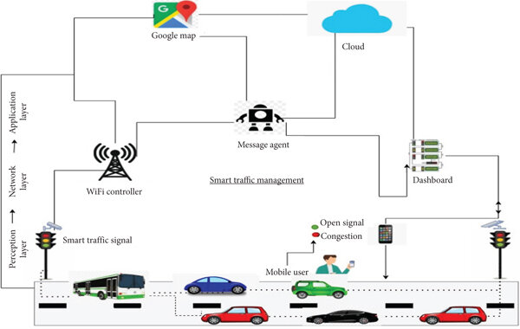

Slide 11
Implementation
Key Features & Functionalities
Real-time vehicle count detection using sensors.
Adaptive signal control based on traffic density.
Emergency vehicle priority system.
Remote monitoring & analytics dashboard.
Vehicle classification using image processing

Slide 12
Results & Discussion
Outcomes of the Project
Reduction in traffic congestion by approximately 30%.
Reduced waiting times at signals with adaptive controls.
Improved road safety with emergency vehicle prioritization.
Enhanced environmental benefits (lower fuel consumption, reduced emissions).

Slide 13
Comparison with Existing Solutions
Feature | Traditional Systems | Smart Traffic System
Fixed Signal Timings | Yes | No
Real-time Adaptability | No | Yes
Emergency Vehicle Priority | No | Yes
Traffic Data Analysis | Limited | Advanced ML Models
Data Visualization
Traffic flow charts before and after implementation.
Time-lapse comparison of peak-hour traffic conditions.

Slide 14
Challenges & Limitations
Issues Faced During Development
Sensor calibration errors affecting vehicle count accuracy.
Network latency in real-time data transmission.
High initial setup cost for IoT deployment.

Slide 15
Future Scope
Integration with Smart City Infrastructure (Connected Vehicles, Smart Parking).
Enhanced AI Models for better traffic prediction.
Deployment of 5G-based traffic monitoring for ultra-low latency

Slide 16
Conclusion
Successfully developed a Smart Traffic Control System using IoT and Network Protocols.
Demonstrated real-time adaptability for traffic congestion reduction.
Future enhancements include AI-driven predictions and city-wide scalability

Slide 17
Thank You!

